Slide 1
components
TOPIC 7
UTM-SERG Research & Consultancy Team
School of Computing
Faculty of Engineering
Universiti Teknologi Malaysia
UTM, Skudai, Johor.

Slide 2
AGENDA
Agenda 1: Component-based software development
Agenda 2: Properties of components
Agenda 3: Component models
Agenda 4: Separation of interface and implementation
Agenda 5: Summary

Slide 3
Component-based software development
Business Layer
C4
C1
= component
C3
C1
UI
C5
C1
Business
Layer
C4
C3
C2
C6
Database
C5
C6
C2
Layered
Modular for
Business Layer
Communicating distributed
components
Each layer may be decomposed into modular distributed architecture
Modular – consists of a few components
Each components will be connected to realize the software
GOAL
A new software is developed based on existing components

Slide 4
Component-based software development
Identified
Developed/Bought
Challenges
Suitable
SDLC
Software
architecture
Integrated with
Existing software

Slide 5
Component-based software development
Software components – An architectural entity that (1) encapsulates
a software functionalities/data (2) access restriction, (3) communicate
via interface (4) defined dependencies between component
CONTEXT INDEPENDENT!!

Slide 6
Properties of components
Defined purpose
Specific functionality ; spellchecker, search engine, reporting
Independent
Loosely coupled; move forward, move backward for robotics components
Location transparent
The location of the components should be visible to any components; at business, UI or database layer
Integrated & composable
Easy to integrate/compose into a software;
Configurable
Easy and fast to configure
Separation
Interface and implementation is completely separated; client does not know the component’s implementation; comm. Only via interface
Versioning
Multiple version based on change requirements
Reusable
Can be used immediately with other software

Slide 7
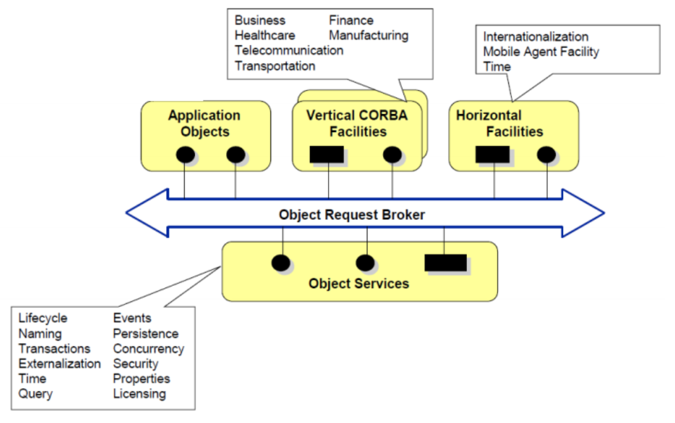
Technical view-example
CORBA

Slide 8
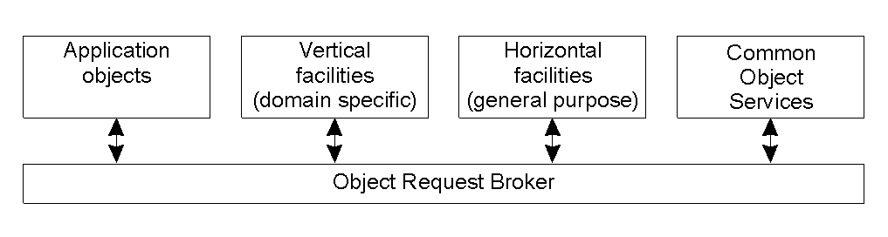
Overview of CORBA
The global architecture of CORBA.

Slide 9
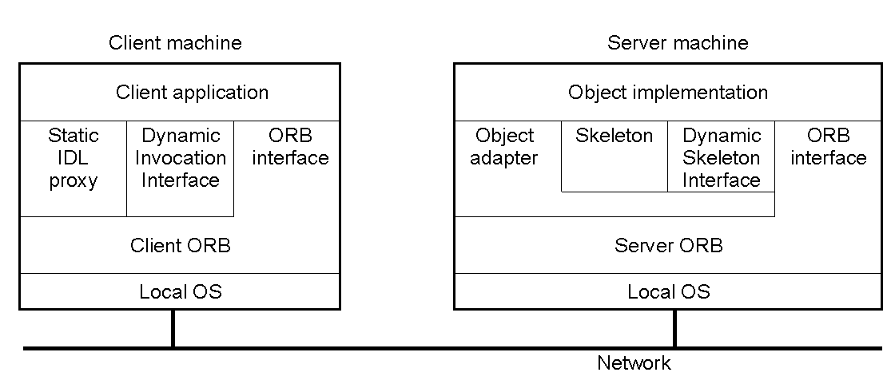
Object Model
The general organization of a CORBA system.

Slide 10
Corba Services
Service | Description
Collection | Facilities for grouping objects into lists, queue, sets, etc.
Query | Facilities for querying collections of objects in a declarative manner
Concurrency | Facilities to allow concurrent access to shared objects
Transaction | Flat and nested transactions on method calls over multiple objects
Event | Facilities for asynchronous communication through events
Notification | Advanced facilities for event-based asynchronous communication
Externalization | Facilities for marshaling and unmarshaling of objects
Life cycle | Facilities for creation, deletion, copying, and moving of objects
Licensing | Facilities for attaching a license to an object
Naming | Facilities for systemwide name of objects
Property | Facilities for associating (attribute, value) pairs with objects
Trading | Facilities to publish and find the services on object has to offer
Persistence | Facilities for persistently storing objects
Relationship | Facilities for expressing relationships between objects
Security | Mechanisms for secure channels, authorization, and auditing
Time | Provides the current time within specified error margins
Overview of CORBA services.

Slide 11
Object Invocation Models
Request type | Failure semantics | Description
Synchronous | At-most-once | Caller blocks until a response is returned or an exception is raised
One-way | Best effort delivery | Caller continues immediately without waiting for any response from the server
Deferred synchronous | At-most-once | Caller continues immediately and can later block until response is delivered
Invocation models supported in CORBA.

Slide 12
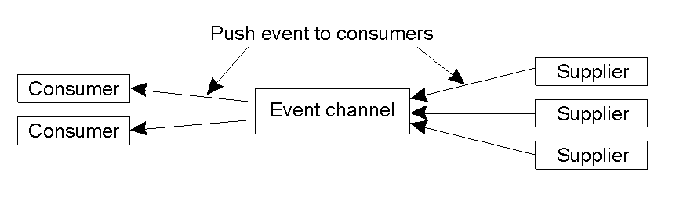
Event and Notification Services (1)
The logical organization of suppliers and consumers of events, following the push-style model.

Slide 13
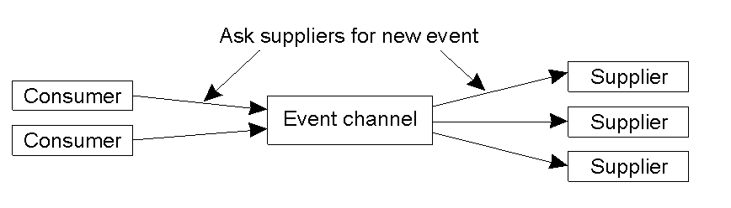
Event and Notification Services (2)
The pull-style model for event delivery in CORBA.

Slide 14
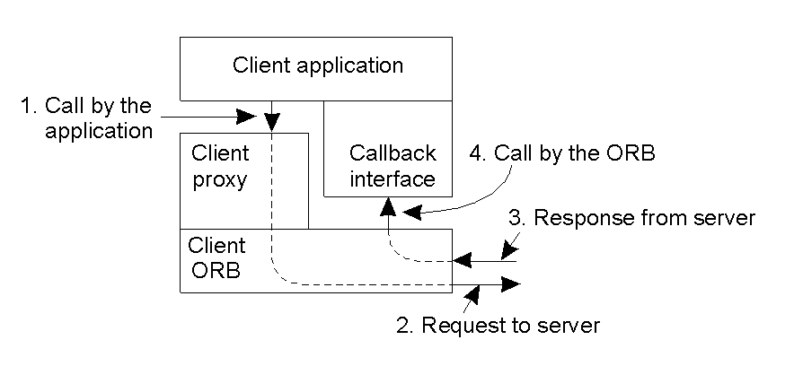
Messaging (1)
CORBA's callback model for asynchronous method invocation.

Slide 15
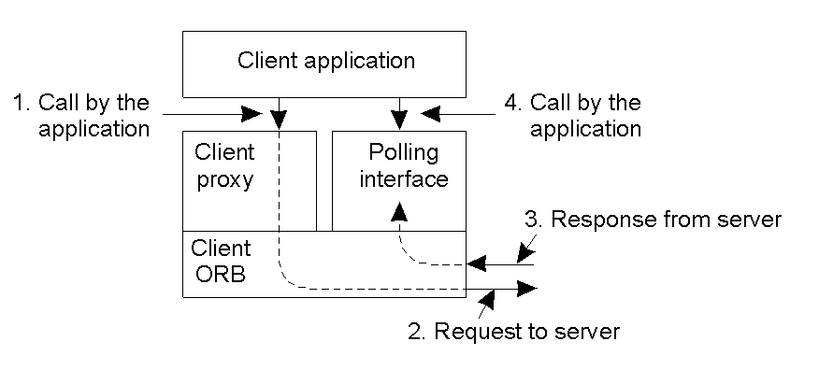
Messaging (2)
CORBA'S polling model for asynchronous method invocation.

Slide 16
Interoperability
Message type | Originator | Description
Request | Client | Contains an invocation request
Reply | Server | Contains the response to an invocation
LocateRequest | Client | Contains a request on the exact location of an object
LocateReply | Server | Contains location information on an object
CancelRequest | Client | Indicates client no longer expects a reply
CloseConnection | Both | Indication that connection will be closed
MessageError | Both | Contains information on an error
Fragment | Both | Part (fragment) of a larger message
GIOP message types.

Slide 17
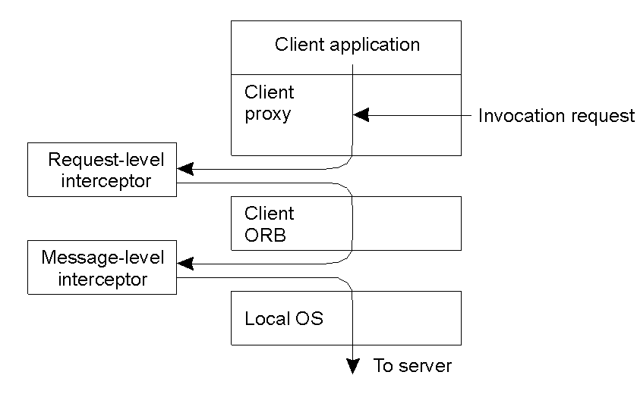
Clients
Logical placement of interceptors in CORBA.

Slide 18
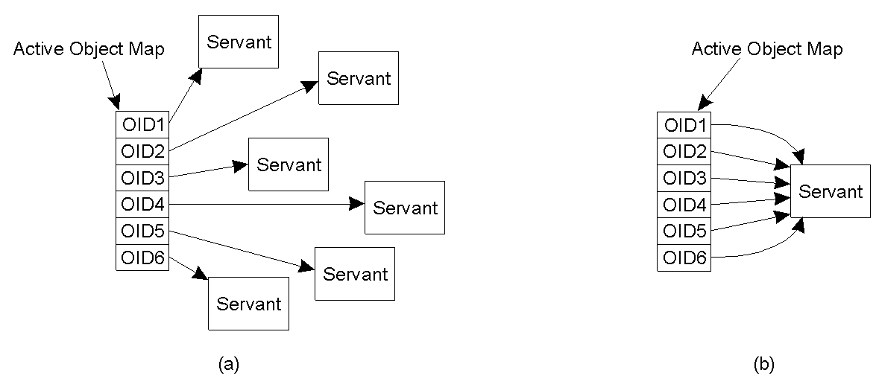
Portable Object Adaptor (1)
Mapping of CORBA object identifiers to servants.
The POA supports multiple servants.
The POA supports a single servant.

Slide 19
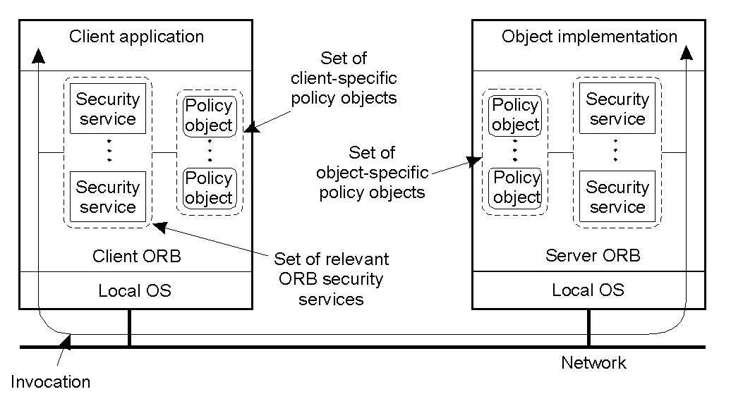
Security (1)
The general organization for secure object invocation in CORBA.

Slide 20
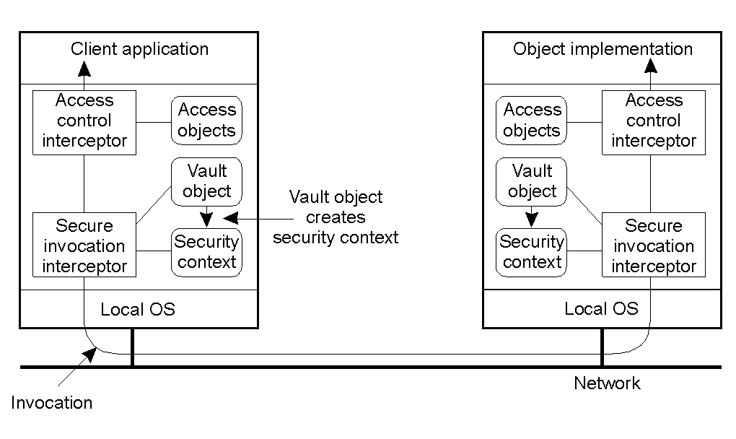
Security (2)
The role of security interceptors in CORBA.

Slide 21
Component models
Software Component – A software element that realize the component models
Software
component
Component models
Framework
Conforms to
Conforms to
Implementation
Interoperability
Customization
Composition
Evaluation
Deployment
Component models

Slide 22
Component models
Component Model
WHAT
WHY
HOW
Independently deployed
Realized by software components
Target for specific domain
Develop by specific platform
(JAVA, C++, etc)
Reusability
Cost
Time to market
Quality
Develop for reuse
Develop from reuse

Slide 23
Component models
SDLC

Slide 24
Modelling components
UML

Slide 25
Modelling components

Slide 26
Separation of interface and implementation
Interface
Versioning
Interface as contracts
Provided by components
Required interface
Provided interface –
implementation class
Class is realized by object
Refer to these links for full explaination:
  https://www.youtube.com/watch?v=ipKJwnPsst8
  http://www.newthinktank.com/2012/11/uml-2-0-component-diagrams/

Slide 27
Summary
Components – building blocks based on component models
Create, compose and deploy
Specific architecture based on used and domain
Interfaces are the most important concept in components.

